Slide 1
Investigating applications of the Feynman Path Integral
George Sellers
University of Bath – Department of Physics

Slide 2
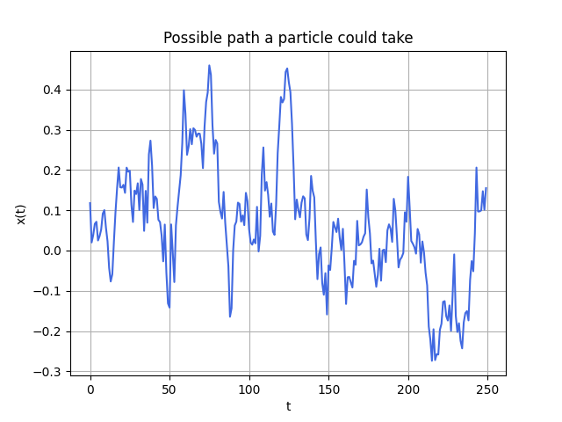
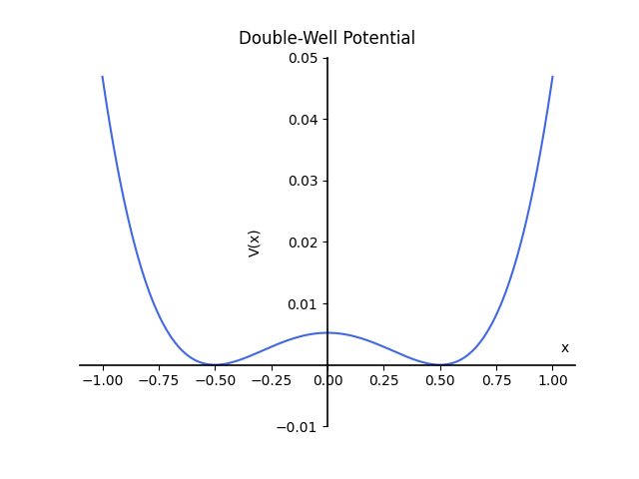


Content of the presentation:
$$Hψ=iℏ\frac{∂ψ}{∂t}$$
Energy levels, wavefunctions and more information extracted.
$$K\left(x_{f},t_{f};x_{i},t_{i}\right)=\left\langle x_{f}\left|e^{−iHT}\right|x_{i}\right\rangle$$

Slide 3
Defining the Path Integral (PI)

Slide 4
General structure for the main body:
Point A about the
Equation here, for example the propagator
Equation here, for example the propagator
Completed tasks/results:
Task A
Task B
Figure here?

